Slide 1
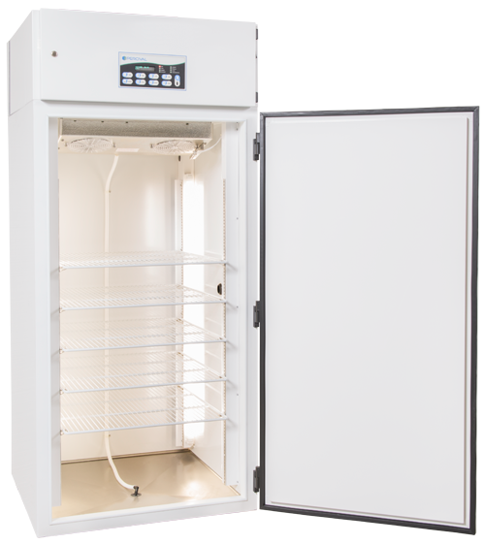
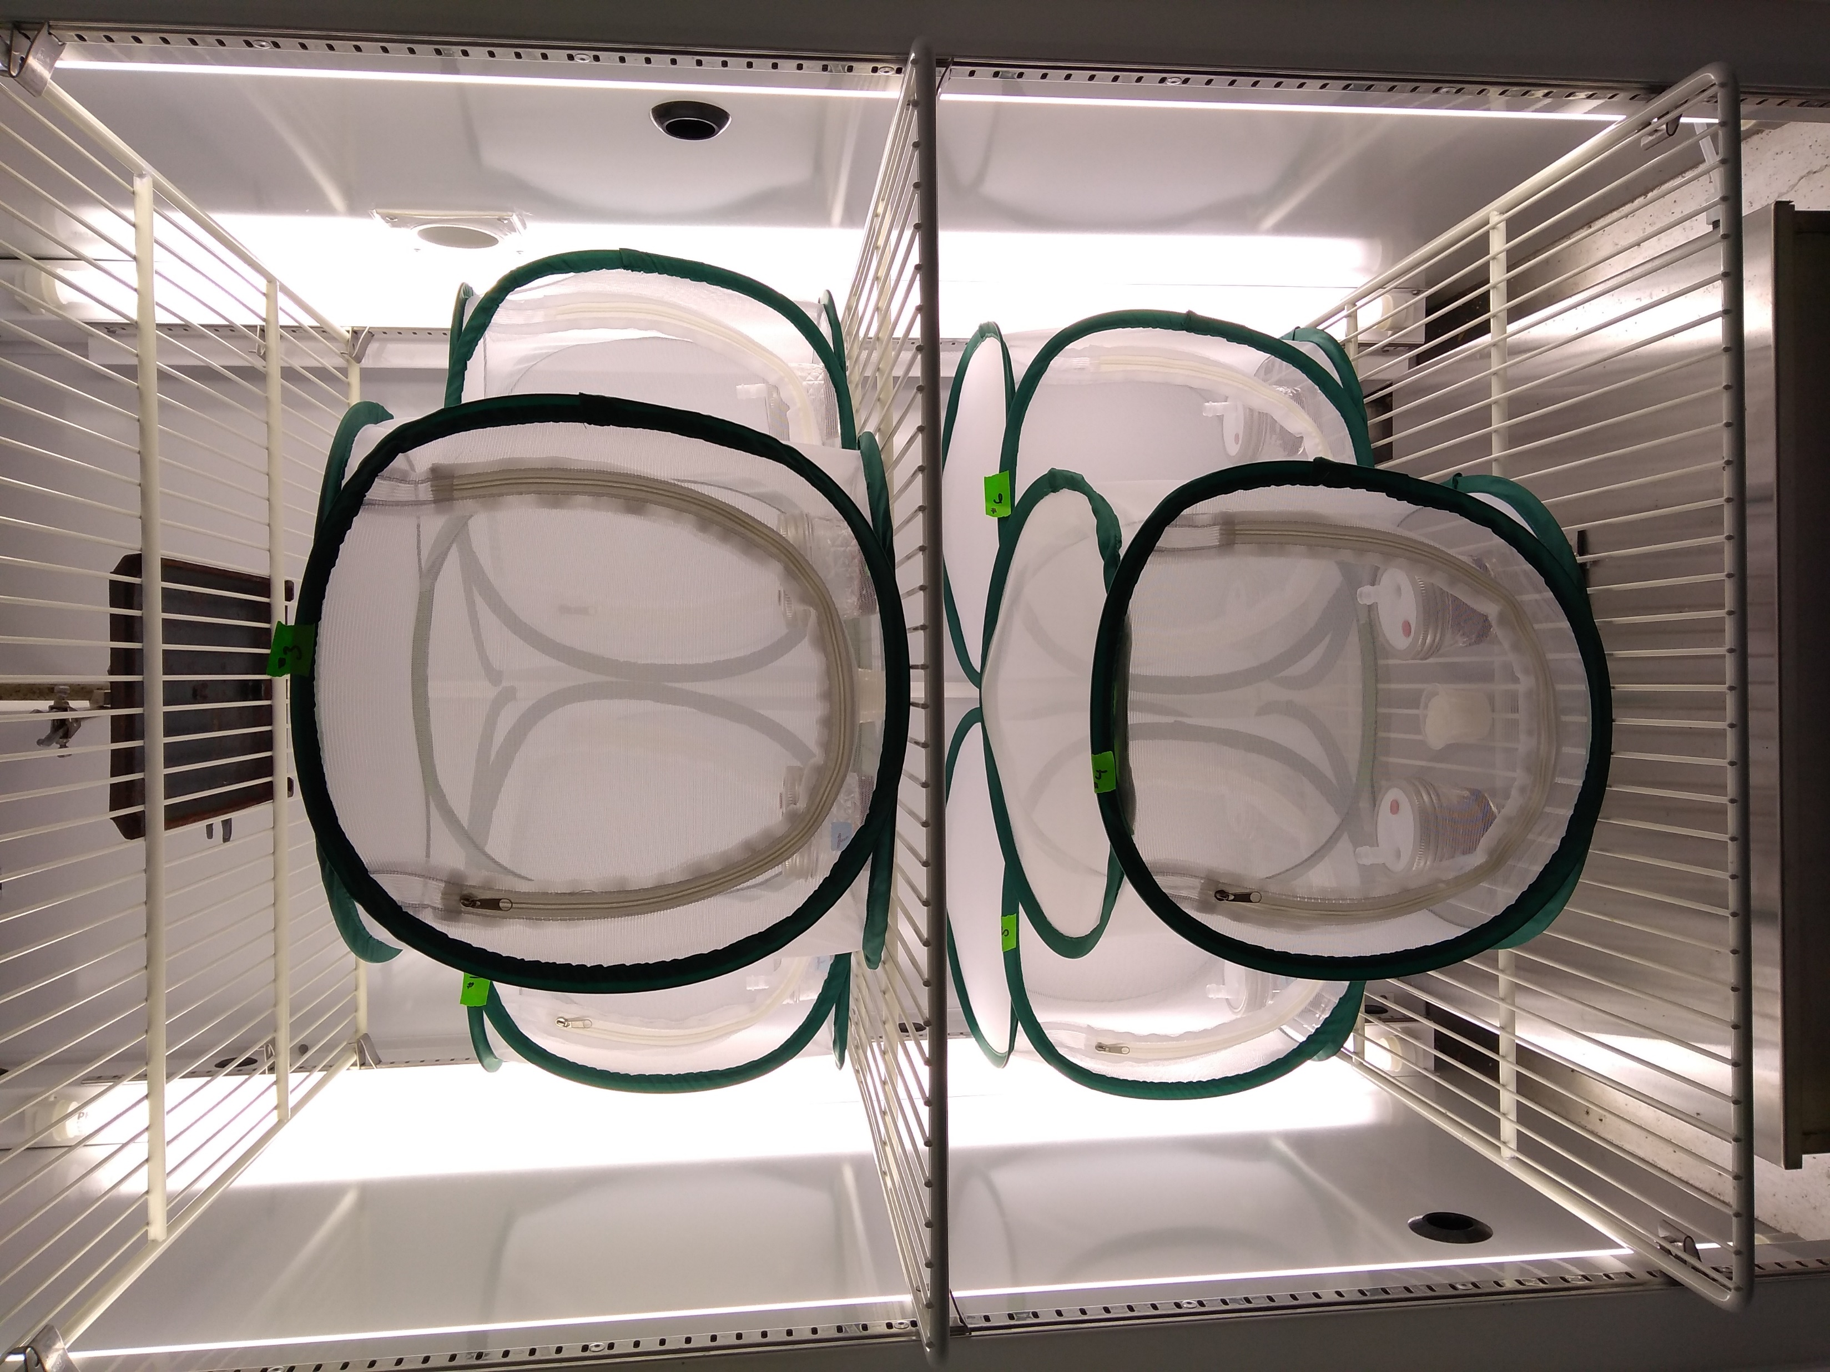
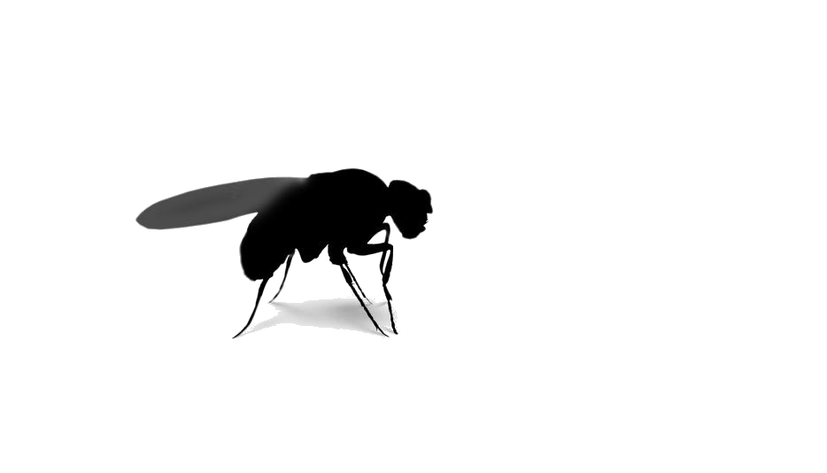
Experimental Weeks: 1, 2, & 3
SWD Choice: Microbe vs Control
Frigoribacterium faeni
Pantoe agglomerans
1x
5 Cages Total:
1 Control Cage
1 Control Jar: 10% Juice
1 Treatment Jar: 10% Juice + Microbe
NO Flies
Treatment Cages
1 Control Jar: 10% Juice
1 Treatment Jar: 10% Juice + Microbe
50 SWD flies
1x
5 Cages Total:
1 Control Cage
1 Control Jar: 10% Juice
1 Treatment Jar: 10% Juice + Microbe
NO Flies
Treatment Cages
1 Control Jar: 10% Juice
1 Treatment Jar: 10% Juice + Microbe
50 SWD flies
7x
7x

Slide 2
Protocol
Environment: 22 C, 40% rH, 16L:8D photoperiod
50 flies per each chamber will be removed from food source 24 hours prior to entering the treatment arenas and provided only water.
Microbes will be cultured 20 to 24 hours prior to inoculation.
Microbes will be inoculated into treatment at time zero.
Flies will be added to treatment arenas at time zero
Fly choice will be counted 2 hours, 24 hours, and 48 hours after time zero.

